Slide 1

Fluid Power Introduction
All images reprinted with permission of National Fluid Power Association
Principles of Engineering
© 2012 Project Lead The Way, Inc.

Slide 2
Fluid Power Definitions
Fluid Power
The use of a fluid to transmit power from one location to another
Hydraulics
The use of a liquid flowing under pressure to transmit power from one location to another
Pneumatics
The use of a gas flowing under pressure to transmit power from one location to another

Slide 3
Why Use Fluid Power?
Multiplication and variation of force
Easy, accurate control
One power source controls many operations
High power / low weight ratio
Low-speed torque
Constant force and torque
Safe in hazardous environments
Notes:
Multiplication and variation of force - Output can be very closely controlled and can provide large amounts of power.
Easy, accurate control - You can start, stop, accelerate, decelerate, reverse, or position large forces with great accuracy.
Multifunction control - Many processes can be controlled in a single fluid power system.
High horsepower, low weight ratio - Pneumatic components are compact and lightweight. You can hold a five horsepower hydraulic motor in the palm of your hand.
Low-speed torque - Large amounts of torque force can be created at slower speeds, unlike many electric motors.
Constant force or torque - Force and torque outputs experience very little fluctuation.
Safety in hazardous environments - Fluid power can be used in mines, chemical plants, near explosives, and in paint applications because it is inherently spark-free and can tolerate high temperatures.

Slide 4
Basic Fluid Power Components
Reservoir / Receiver
  Stores fluid
Fluid Conductors
  Pipe, tube, or hose that allows for flow between components
Pump / Compressor
  Converts mechanical power to fluid power
Valve
  Controls direction and amount of flow
Actuators
  Converts fluid power to mechanical power

Slide 5
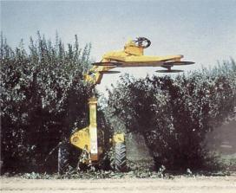
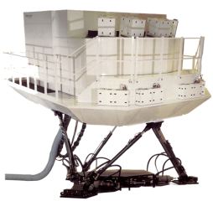
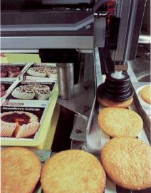

Fluid Power Examples

Slide 6


Fluid Power Physics
Energy
The ability to do work
Energy Transfer
From prime mover, or input source, to an actuator, or output device

Slide 7
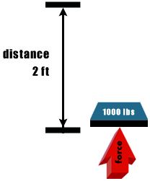
Fluid Power Physics
Work
Force multiplied by distance
Measured in foot-pounds (ft-lb)
Example:
How much work is completed by moving a 1000-lb force 2 ft?
2000 ft-lb of work

Slide 8
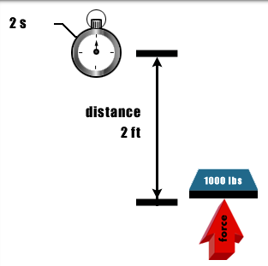
Fluid Power Physics
Power
The rate of doing work
Work over time in seconds
Example:
How many units of power are needed to lift a 1000-lb force 2 ft in 2 s?
1000 units of power
(1000 lb x 2 ft) / 2 s

Slide 9
Fluid Power Principles
Horsepower
Hydraulic power is given by:
Power = flow x pressure drop,
Horsepower is a common unit for power
1 hp = 1714 gal/min x 1 psi

Slide 10
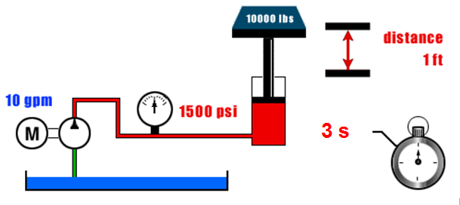


Fluid Power Principles
Calculate the horsepower provided by the system below to lift a 10,000 lb force in 3 s.
Notes:
Note that the power output of the system is P = E/t = Fd/t = (10000 lb) (1 ft) / (3 s) = 3333 ft-lb/s=4526 W
While the power input of the system is 8.75 hp = 6525 W,
And efficiency of 4526 W/6525 W = 69%

Slide 11
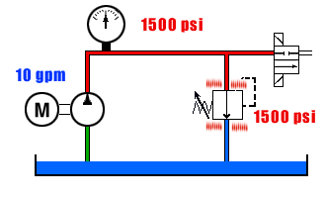
Fluid Power Principles
Heat
Law of conservation of energy states that energy can neither be created nor destroyed, although it can change forms.
Energy not transferred to work takes the form of heat energy.

Slide 12
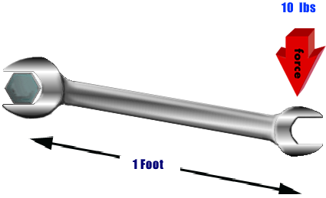
Fluid Power Principles
Torque
Twisting force
force x distance
Measured in foot-pounds
Calculate the torque produced when 10 lb
of force is applied to a 1-ft-long wrench.

Slide 13
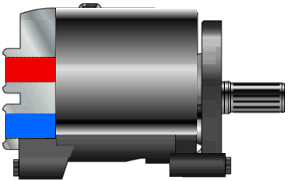
Fluid Power Principles
Torque
The twisting force applied by a hydraulic or pneumatic motor
Motor rpm at a given torque specifies power usage or horsepower requirement

Slide 14
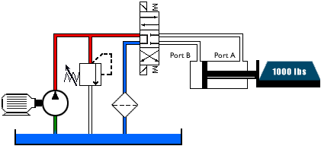
Fluid Power Principles
Flow
Makes actuator operation possible
Retracted cylinder
To extend the cylinder, flow must be directed into port B.

Slide 15
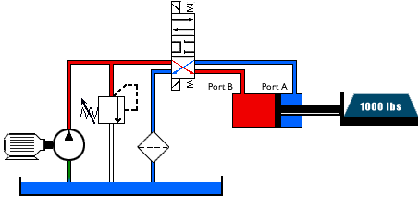
Fluid Power Principles
Flow
Makes actuator operation possible
Flow is directed into port B and cylinder is extended.
To retract the cylinder, flow must be directed into what port?

Slide 16
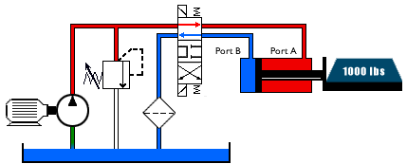
Fluid Power Principles
Flow
Makes actuator operation possible
The cylinder retracts when flow is directed into Port A.
To retract the cylinder, flow must be directed into what port?

Slide 17
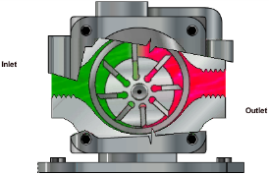
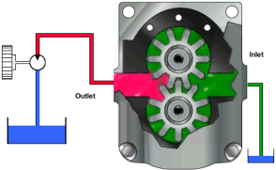
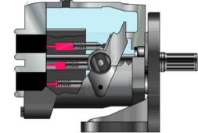
Fluid Power Principles
Rate of Flow
Determines actuator speed
Measured in gallons per minute (gpm)
Generated by a pump

Slide 18
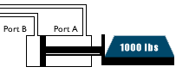
Fluid Power Principles
With a Given Flow Rate
Actuator volume displacement directly affects actuator speed
The less volume to displace, the faster the actuator
Will the actuator illustrated below travel the same speed as it retracts and extends if a constant flow rate is maintained?
No. The actuator will travel faster as it retracts due to less volume caused by the actuator shaft.

Slide 19
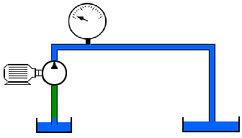
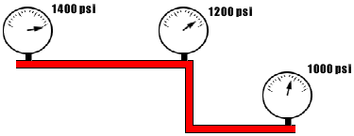
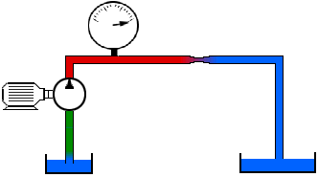
Fluid Power Principles
Pressure
Overcomes the resistance to flow
Pumps produce flow by pressurizing the fluid
- A pump can create greater pressure at lower flow rate, so if you restrict the flow from the pump, greater pressure will result.
All points of resistance in series within a system contribute to total system resistance, including long runs of pipe, elbows, etc.

Slide 20
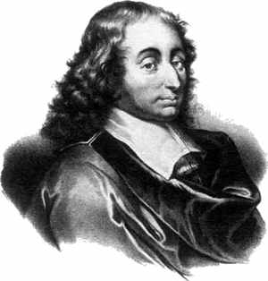

Fluid Power Principles
Definition of pressure
Relationship between force, pressure, and area
Blaise Pascal developed concepts about pressure in the 1640’s.
The SI unit for pressure is the pascal (Pa). 1 Pa = 1 N/m²
Notes:
Blaise Pascal invented the hydraulic press. Earth’s atmospheric pressure of 14.7 psi is equal to about 101,000 pascals

Slide 21
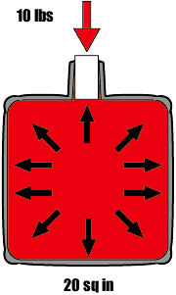
Fluid Power Principles
Pascal’s Law
Pressure applied on a confined fluid at rest is transmitted undiminished in all directions and acts with equal force on equal areas and at right angles to them.
How much force is exerted on every square inch of the container wall illustrated on the right if 10 lb of force is applied to the 1-in² stopper?
10 lb
What is the total resulting force acting on the bottom of the container?
200 lb

Slide 22
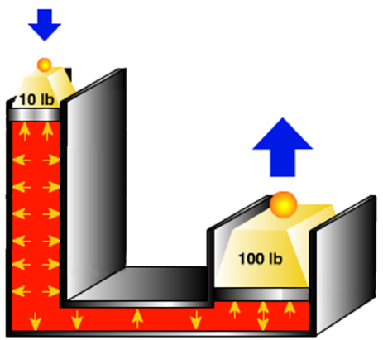
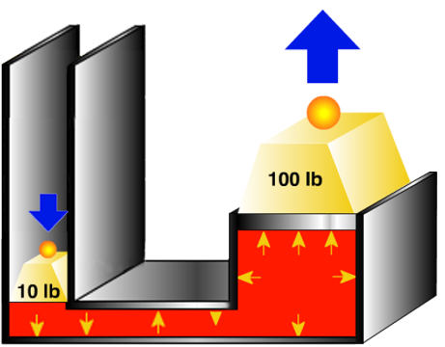
Pascal’s Law
Fluid Power Principles
Hydraulic Press
10 lb can lift 100 lb
What is the tradeoff?
Distance
National Fluid Power Association
Notes:
Pascal's law is the basis for all fluid power that relies on pressure in the system.

Slide 23
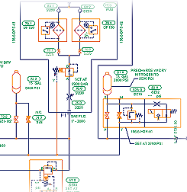
Fluid Power Schematics
Schematics
Line drawing made up of a series of symbols and connections that represent the actual components in a hydraulic system

Slide 24
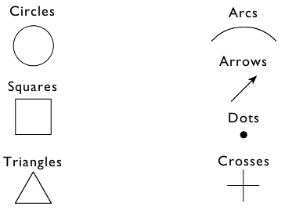
Fluid Power Schematics
Symbols
Critical for technical communication
Not language-dependent
Emphasize function and methods of operation
Basic Symbols

Slide 25
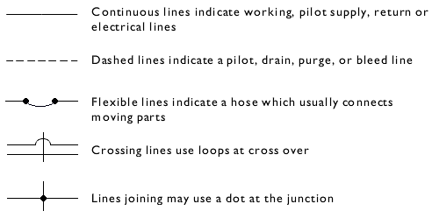

Fluid Power Schematics
Lines
Components (like this filter) inserted into lines

Slide 26
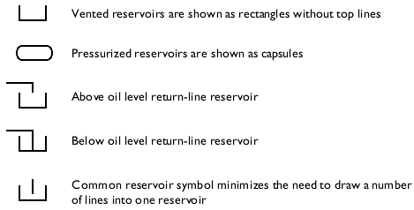
Fluid Power Schematics
Reservoirs

Slide 27
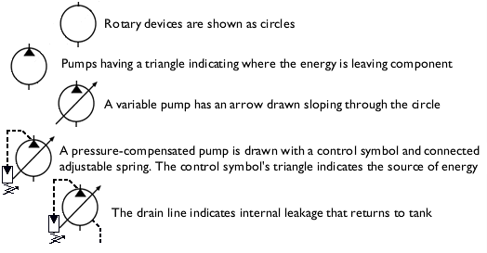
Fluid Power Schematics
Pumps

Slide 28
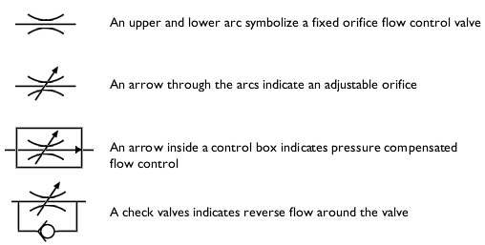
Fluid Power Schematics
Flow Control Valves

Slide 29
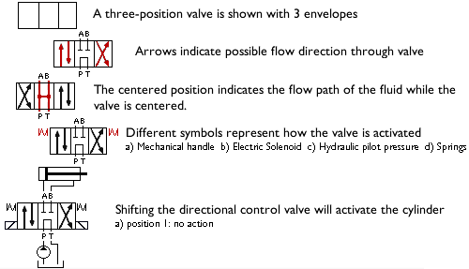
Fluid Power Schematics
Directional Control Valves

Slide 30
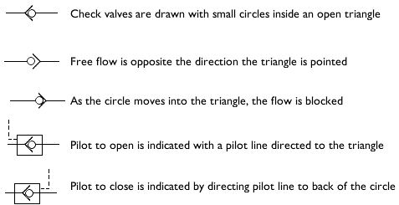
Fluid Power Schematics
Check Valves

Slide 31
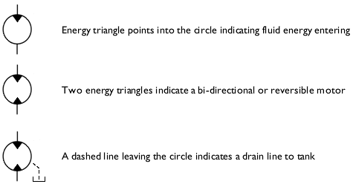
Fluid Power Schematics
Motors

Slide 32
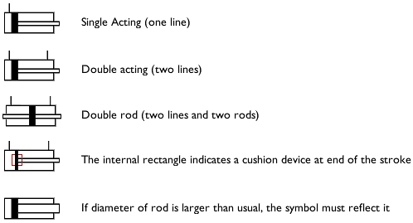
Fluid Power Schematics
Cylinders

Slide 33
Resources
National Fluid Power Association. (2000). Fluid power training.
National Fluid Power Association. (2008). What is fluid power. Retrieved February 15, 2008, from http://www.nfpa.com/OurIndustry/OurInd_AboutFP_WhatIsFluidPower.asp
National Fluid Power Association & Fluid Power Distributors Association. (n.d.). Fluid power: The active partner in motion control technology. [Brochure]. Milwaukee, WI: Author

