Slide 1
Activity 1.3.1a Solar Hydrogen Automobile Assembly Guide
VEX® Platform
Principles of Engineering

Slide 2
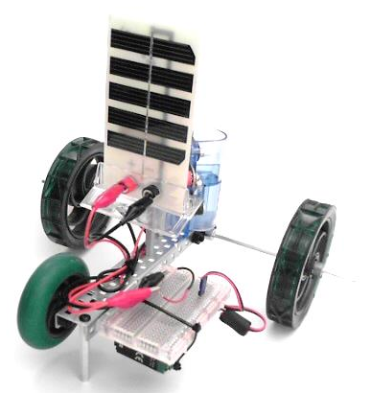
Equipment
POE VEX® Kit
Alligator jumper cables
22-gauge wires
breadboard

Slide 3
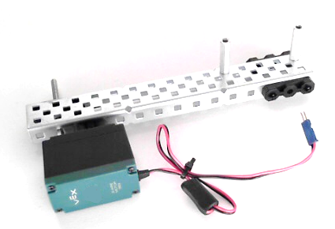
Step 1: Build Chassis
Attach (3) bearing flats using (6) bearing rivets
Attach (2) 1 in. standoffs using (2) 3/8” 6-32 screws
Attach (1) 269 or 393 Motor using
(2) ¼” 6-32 screws
(1) 3 in. shaft
(1) Shaft collar

Slide 4
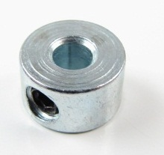
Step 2: Attach Wheels
Install (1) 12 in. shaft secured with (2) shaft collars
Install (1) 2.75” wheel with (1) nylon spacer and
(1) shaft collar
Install (2) 4” wheels using (4) shaft collars
x2 wheels

Slide 5
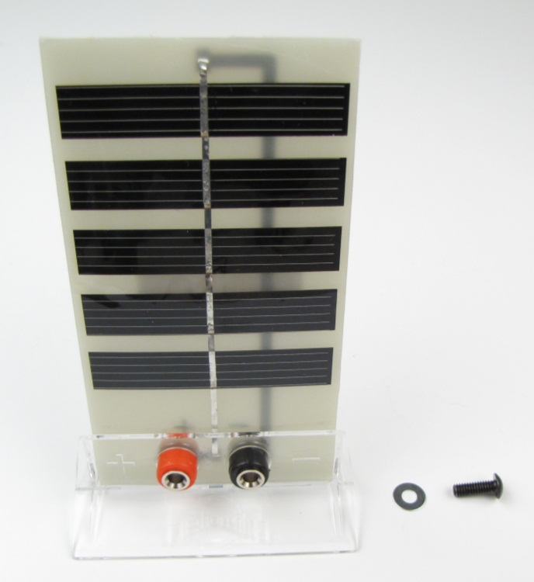
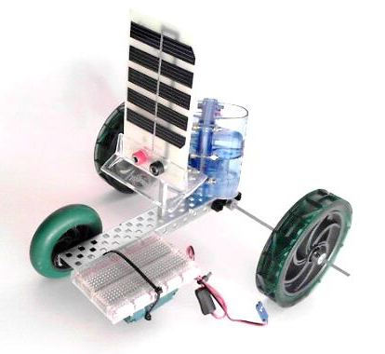
Step 3: Attach Solar Module. Add Fuel Cell and Breadboard
Attach the solar module using a 2” standoff and a 8-32 screw.
Fuel cell rests securely between previously installed standoffs.
Attach breadboard with zip ties threaded between drive shaft and motor screw stems.

Slide 6
Step 4a: Electrically Connect Motor and Hook up Wires
Note: Next slides will show steps to create this circuit

Slide 7
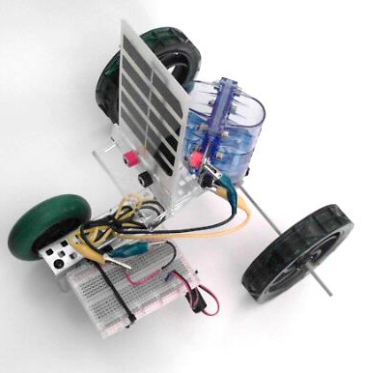
Step 4b: Physical Circuit
Extra insulation striped off 22-gauge wires provides attachment point for alligator jumper cables.

